Slide 1
E-Commerce Real-Time
Analytics Pipeline
End-to-End Data Engineering Final Project
Apache Airflow
dbt
Docker
PostgreSQL
Metabase
40.000
9.954
2M
50.36
Transactions
Customers
Revenue
AOV
Data Engineering Final Project | 2026

Slide 2
Final Project Data Engineering
By Ary Kurniawan
· Airflow · dbt · PostgreSQL · Metabase · Docker
Pipeline mampu mengolah 10.000 transaksi → actionable insights dalam < 10 menit, otomatis 24/7 ✓

Slide 3
Problem Statement & Business Requirements
❓ Bagaimana membangun pipeline data end-to-end yang mampu mengolah transaksi e-commerce secara batch processing,
dengan transformasi terdokumentasi, orkestrasi otomatis, dan visualisasi real-time untuk mendukung keputusan bisnis?
BR-01
BR-02
BR-03
Revenue Analytics
Customer Intelligence
Fraud Detection
Revenue per CC provider, market share, AOV, price tier distribution
Segmentasi VIP/Regular/Occasional/One-time, CLV, histori perubahan (SCD2)
4 rule-based flags: high value, expired CC, abnormal CVV, high-risk customer
BR-04
BR-05
Behavioral Analytics
Operational Excellence
Browser, bahasa, AM/PM, OS, profesi vs nilai transaksi
Batch harian 01:00 WIB, DQ monitoring per jam, SLA < 15 menit

Slide 4
Arsitektur Batch Pipeline
SOURCE
CSV File
batch_ingest.py
Airflow
PostgreSQL
10K rows
Python + psycopg2
DAG daily 01:00 WIB
INGESTION
raw → staging
→ marts → dw
STORAGE
TRANSFORM
dbt
9 models, 87 tests
SERVING
Marts Layer
Metabase
Gold tables (dbt)
12+ panels
VISUALIZE
DW Layer
Analytics
Star Schema + SCD2
Fact + Dim tables
🔍 MONITORING | Airflow DQ DAG (setiap jam) · monitoring.pipeline_runs · monitoring.dq_results · Metabase Pipeline History

Slide 5
Dataset & Data Profiling — Ecommerce_Purchases.csv
Kolom
Tipe
Insight
Address
text
Alamat customer
10,000
14
AM or PM
varchar(2)
AM=4932 | PM=5068
Total Rows
Kolom
Browser Info
text
Mozilla 79.2% | Opera 20.8%
9,954
0
CC Provider
varchar
10 providers unik
CC Exp Date
varchar
Format MM/YY
Unique Customers
Missing Values
CC Security Code
int
CVV: 3-digit normal
9,526
1,689
Email
varchar
9,954 unique emails
Expired CC (95.3%)
CVV Abnormal (16.9%)
Language
varchar
9 bahasa (de,ru,el,pt,en,fr,es,it,zh)
Purchase Price
float
$0.00 – $99.99 | Mean $50.35
⚠️ CRITICAL FINDING: 9,526 dari 10,000 kartu kredit (95.3%) sudah EXPIRED per Maret 2026 → Menjadi dasar utama fraud detection rules dalam pipeline ini

Slide 6
ERD & Schema Design — 5-Layer Database Architecture
RAW
STAGING
DW
MARTS
ecommerce_purchases
(id PK, email, credit_card,
cc_provider, purchase_price,
ingested_at, batch_id)
stg_purchases
(purchase_id PK, email FK,
cc_provider, price_tier,
is_cc_expired, browser_name)
fact_transactions
(transaction_id PK,
customer_id FK, date_key FK,
is_fraud_flagged)
mart_fraud_signals
(purchase_id PK, email FK,
total_flags 0-4)
kafka_purchase_events
(id PK, event_id UK,
email, purchase_price,
kafka_offset, consumed_at)
int_customer_stats
(email PK, total_txns,
total_spend, preferred_browser,
fraud_risk_score)
dim_customer_scd2
(customer_key PK,
customer_id NK, is_current,
effective_date, version)
mart_sales_summary
(cc_provider PK, total_revenue,
revenue_share_pct)
MONITORING
dim_payment
(payment_key PK,
credit_card_number NK,
is_expired, is_cvv_abnormal)
mart_customer_360
(email PK, customer_segment,
spending_tier, fraud_risk_score)
pipeline_runs
(run_id UK, dag_id,
status, records_written,
duration_secs)
dq_results
(id PK, run_id FK,
check_name, status,
fail_count)
Note : Bronze (Raw) → Silver (Staging) → Star Schema (DW) → Gold (Marts) | Monitoring (Operational)

Slide 7
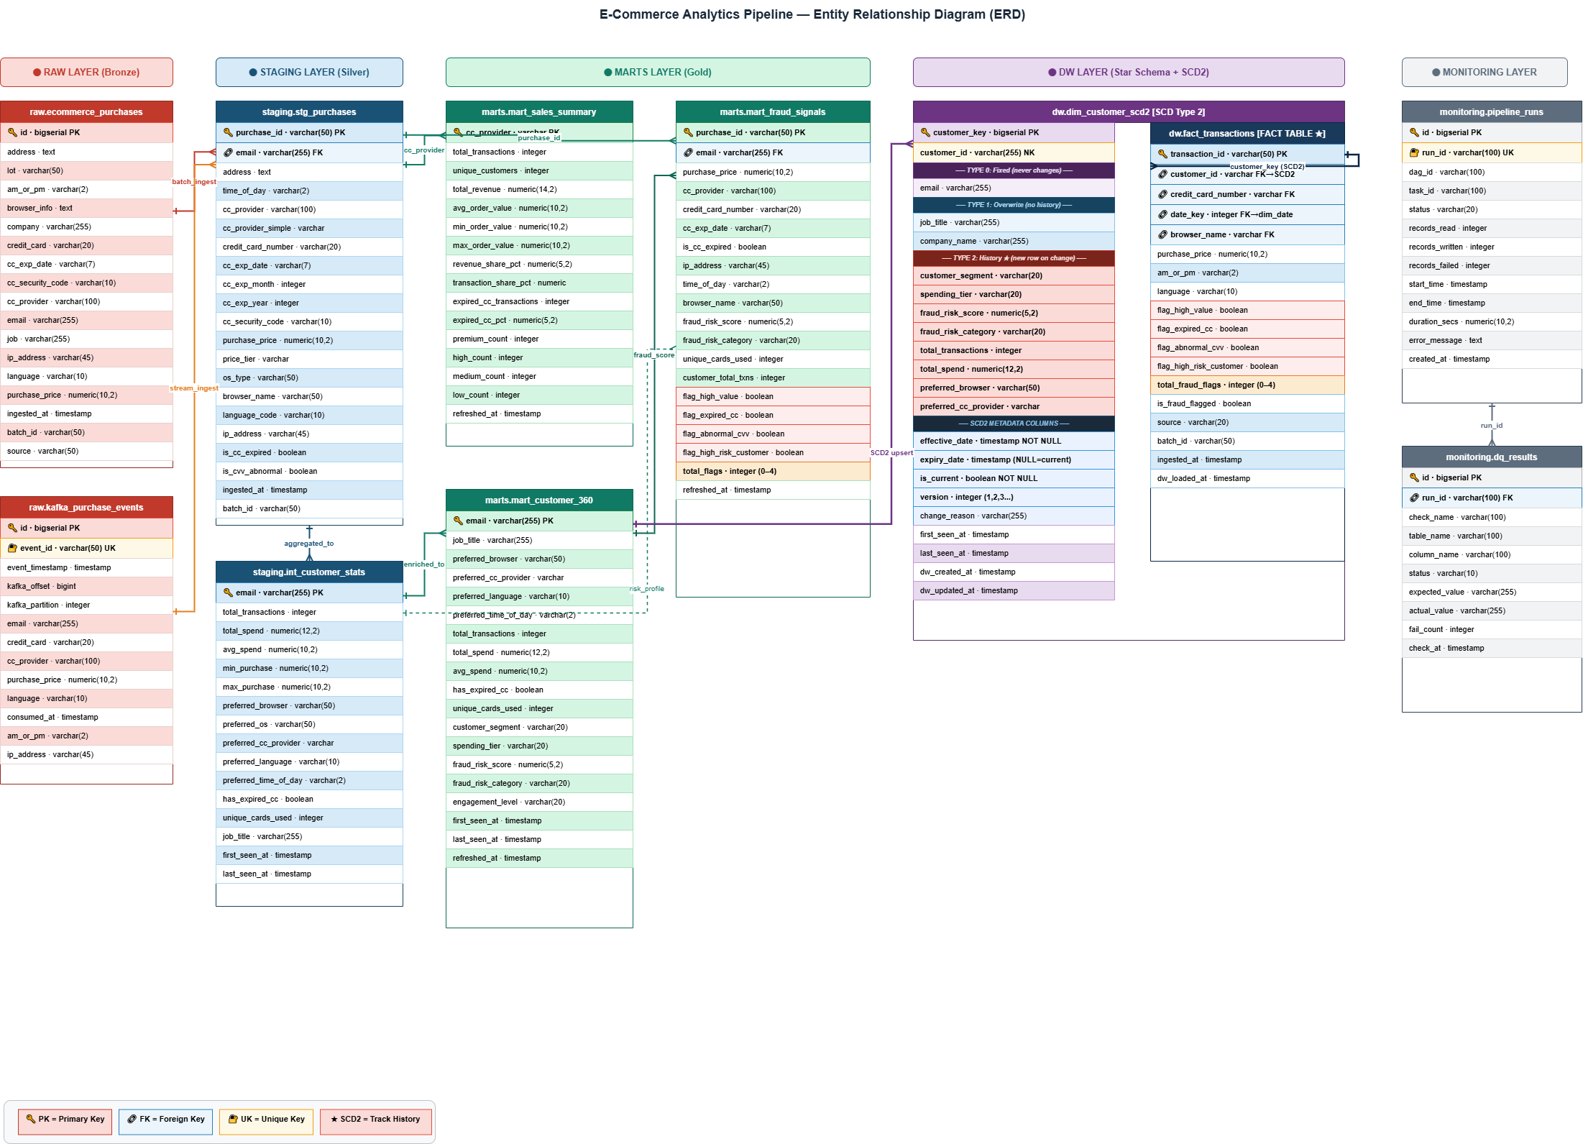
ERD & Schema Design — 5-Layer Database Architecture

Slide 8
dbt Model Lineage — Staging → Intermediate → Marts → DW
raw.
ecommerce_
purchases
STAGING
MARTS
DW (SCD2)
stg_purchases
VIEW | cleaned
mart_sales_summary
Revenue per provider
dim_customer_scd2
SCD Type 2
int_customer_stats
TABLE | per-customer agg
mart_customer_360
Segmentasi + fraud score
dim_payment
SCD Type 1
mart_fraud_signals
4 fraud flags per tx
dim_browser
SCD Type 0
fact_transactions
Star Schema center
9 Models
87 Tests
4 Layers
SCD2
dbt run
dbt test
Bronze→Gold
Histori changes

Slide 9
SCD Type 2 — Slowly Changing Dimension (dim_customer)
Type 0
Fixed
Type 1
Overwrite
Type 2
History ★
Kolom: customer_id
email
Kolom: job_title
company_name
Kolom: customer_segment
spending_tier
fraud_risk_score
Tidak pernah berubah
Timpa langsung,
tanpa histori
Buat baris BARU,
simpan semua versi
Contoh Data — Customer john@email.com berubah segmen dari waktu ke waktu:
customer_key
customer_id
segment
tier
fraud_score
effective_date
expiry_date
is_current
ver
1
john@email.com
One-time
Low
0
2024-01-10
2024-03-15
FALSE
1
2
john@email.com
Occasional
Medium
10
2024-03-15
2024-08-20
FALSE
2
3
john@email.com
Regular
High
30
2024-08-20
NULL
TRUE ✓
3
💡 Kunci SCD2: fact_transactions.customer_key → menunjuk versi customer SAAT TRANSAKSI TERJADI, bukan versi sekarang → analisis historis akurat!

Slide 10
Hasil & Insight Bisnis dari Pipeline
💳 Revenue Analytics
👤 Customer Segmentation
• VISA 16 digit: revenue tertinggi $85,529 (17.0% market share)
• JCB 16 digit: transaksi terbanyak 1,716 transaksi
• Total revenue: $503,473 dari 10,000 transaksi
• Average Order Value: $50.35 per transaksi
• One-time buyer: 9,908 (99.5%) — mayoritas belanja 1x
• Occasional: 46 pelanggan (2-3 transaksi)
• Segmen VIP & Regular: 0 dari dataset ini
• Unique customers: 9,954 dari 10,000 transaksi
🚨 Fraud Detection
📊 Behavioral Analytics
• 9,526 transaksi (95.3%) dengan CC expired → flag_expired_cc
• 1,689 transaksi (16.9%) dengan CVV abnormal → flag_abnormal_cvv
• ~2,564 transaksi high value (>$75) → flag_high_value
• Multi-flag detection: total_flags 0-4 per transaksi
• Browser: Mozilla 79.2% vs Opera 20.8%
• Transaksi AM: 4,932 (49.3%) | PM: 5,068 (50.7%)
• 9 bahasa transaksi: terbanyak de & ru (masing-masing 1,155)
• 623 profesi unik dari 10,000 pelanggan
✅ Pipeline Metrics: Ingest 10K rows = 8.16s | dbt run 9 models = ~14s | dbt test 87/87 passed | Airflow DAG = ~7 menit | Grafana load < 2s

Slide 11
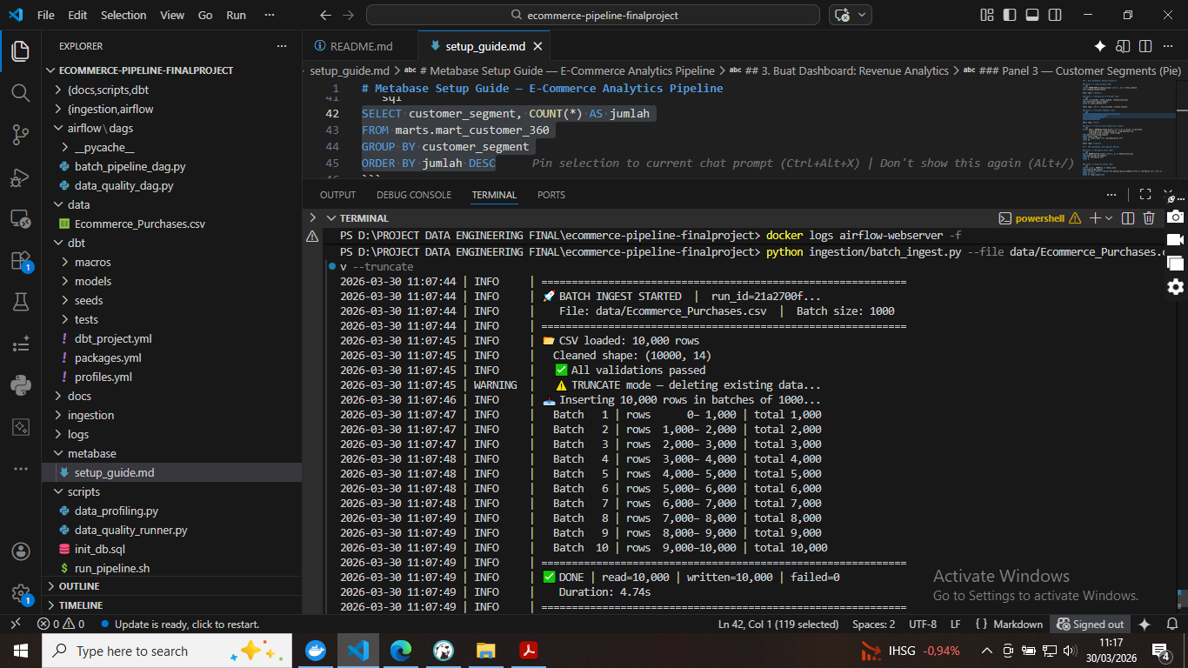

Slide 12
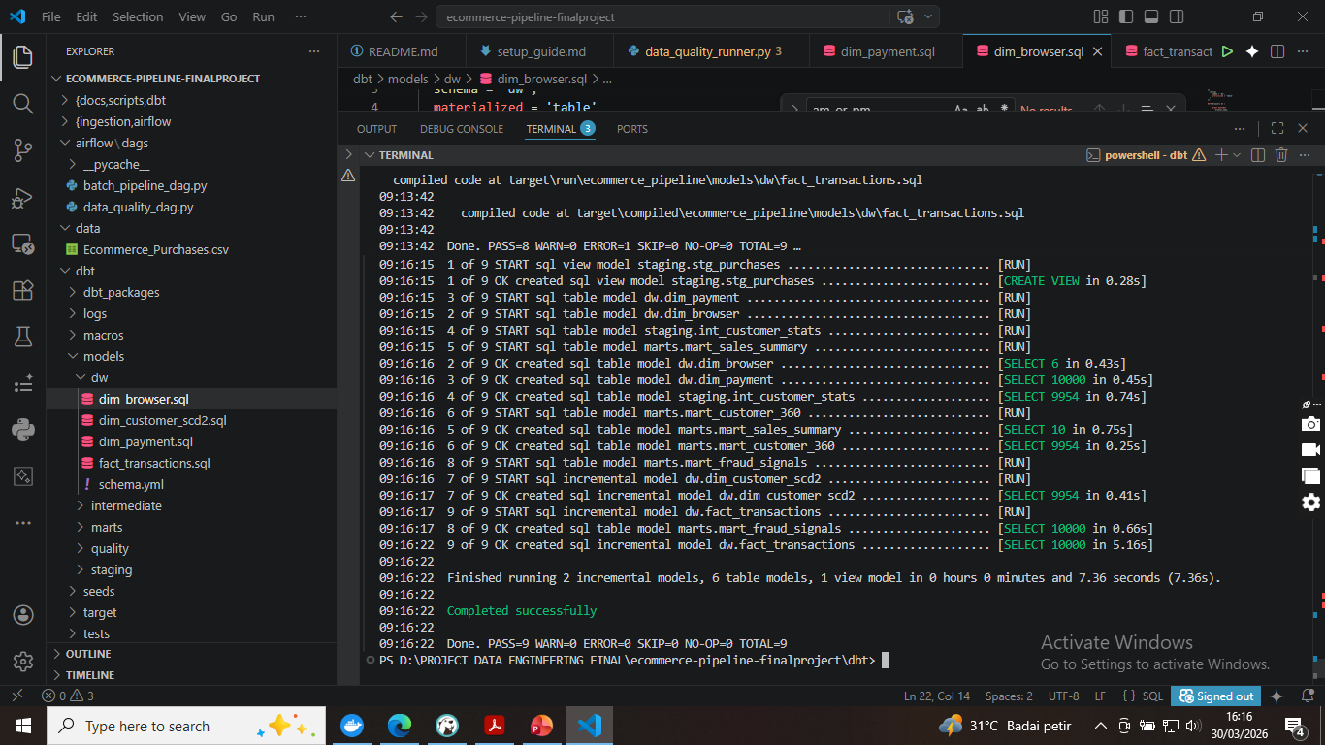

Slide 13
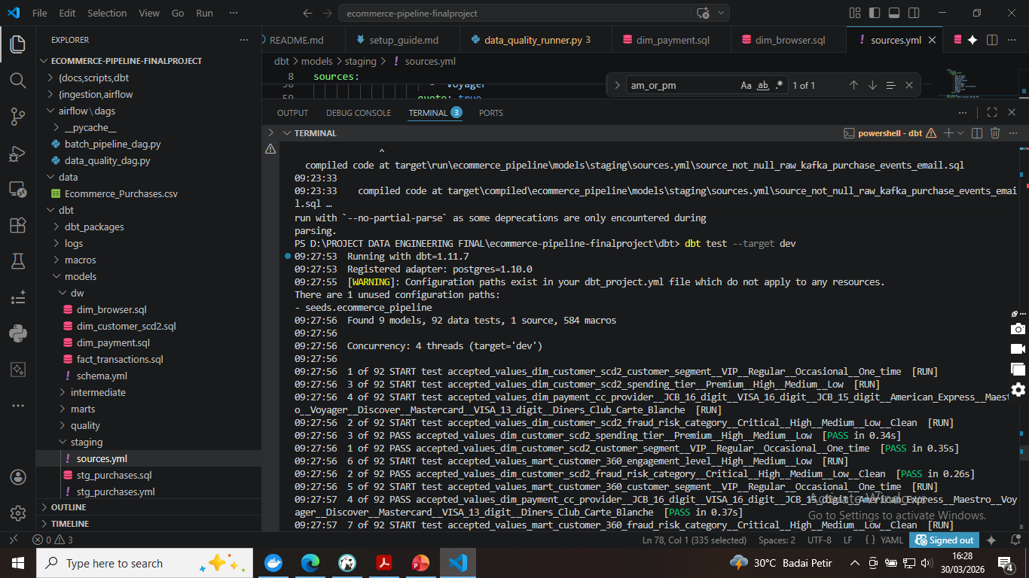

Slide 14
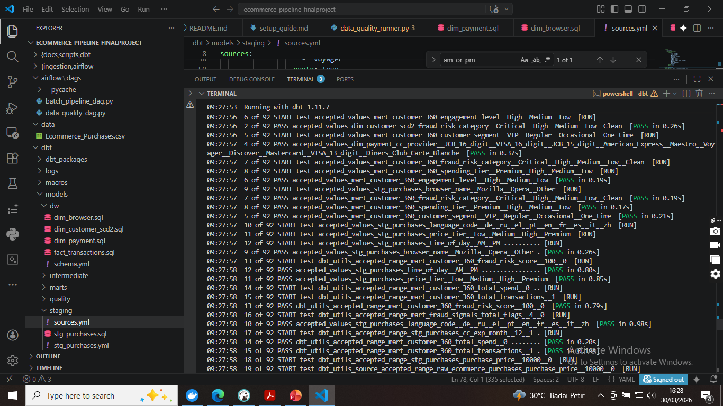

Slide 15
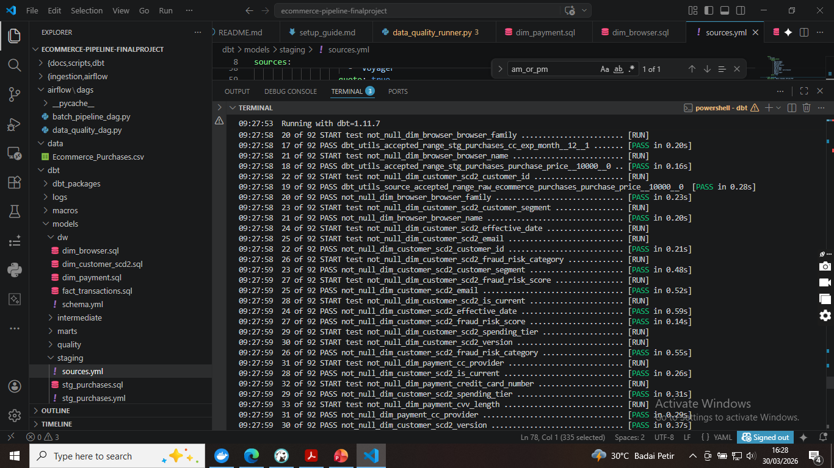

Slide 16
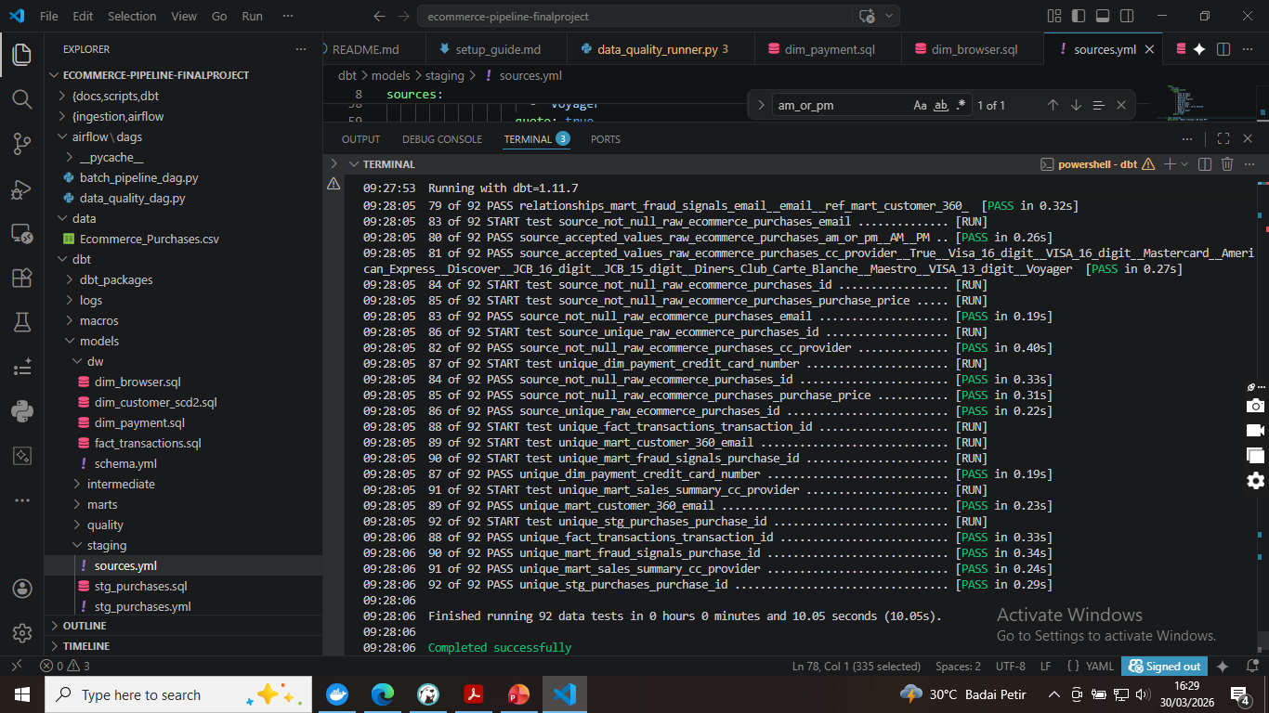

Slide 17
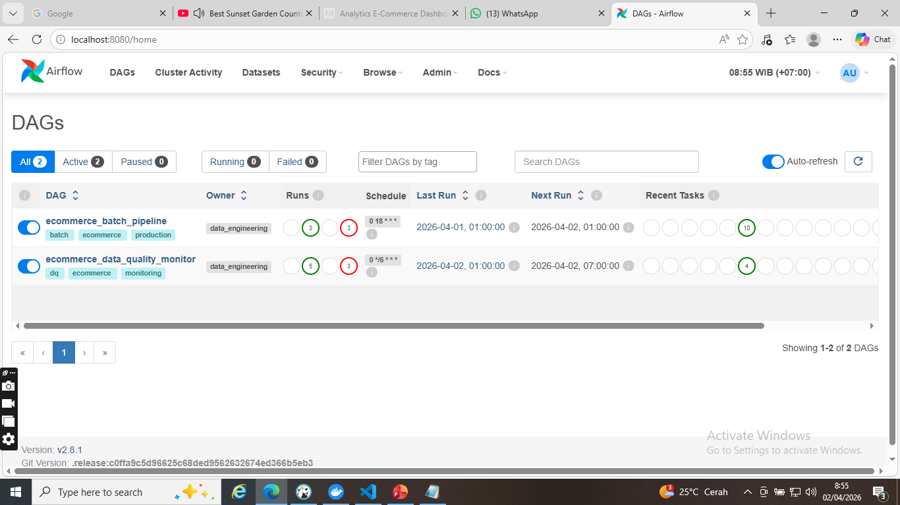

Slide 18
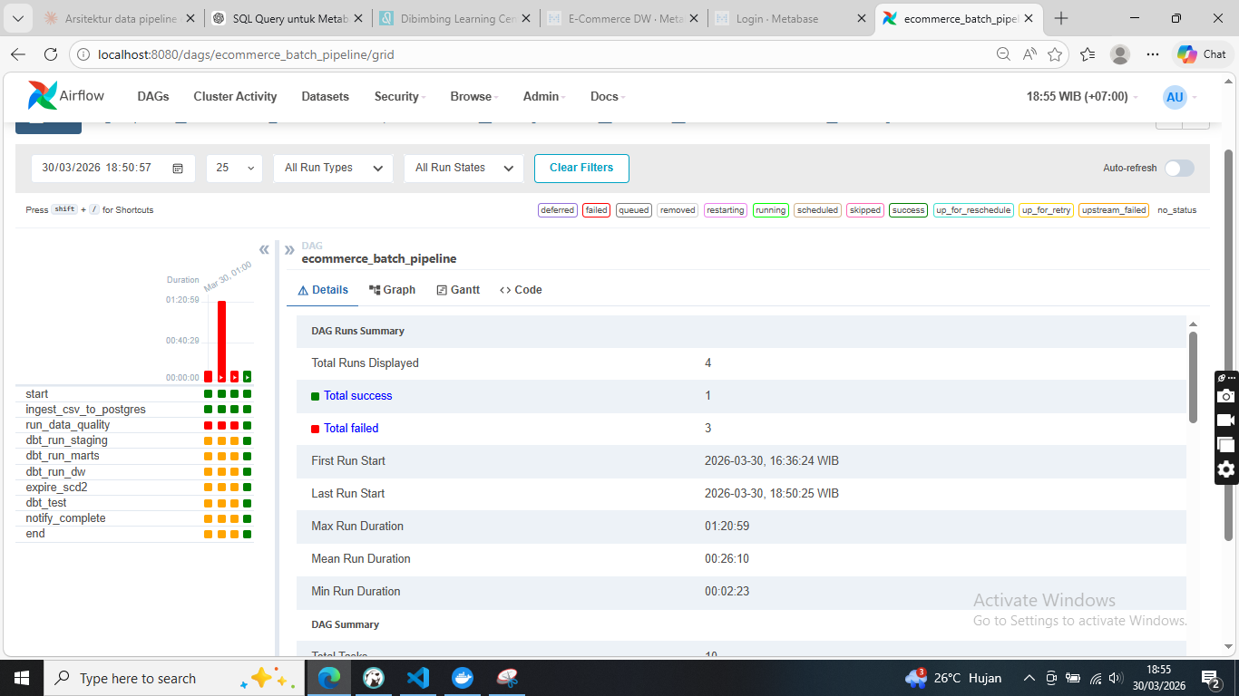

Slide 19
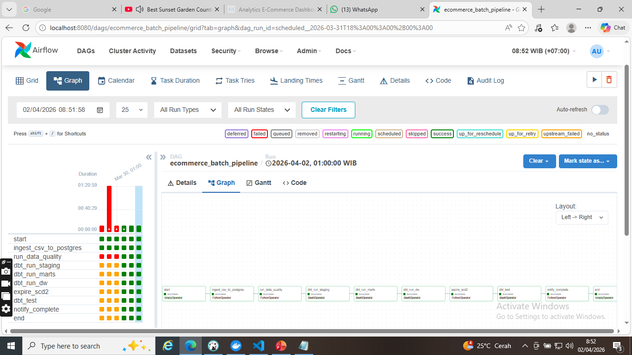

Slide 20
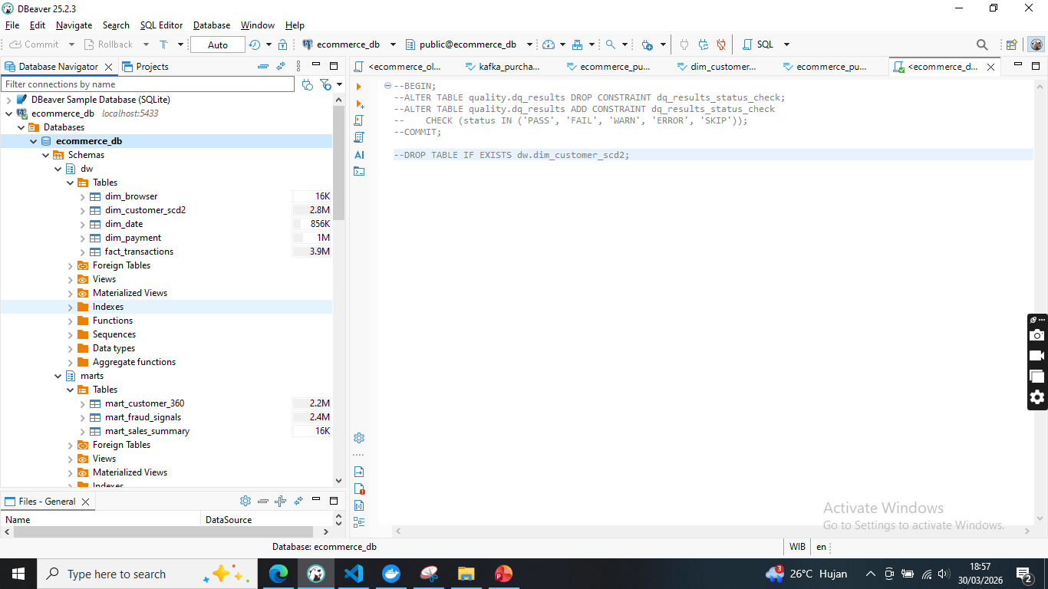

Slide 21
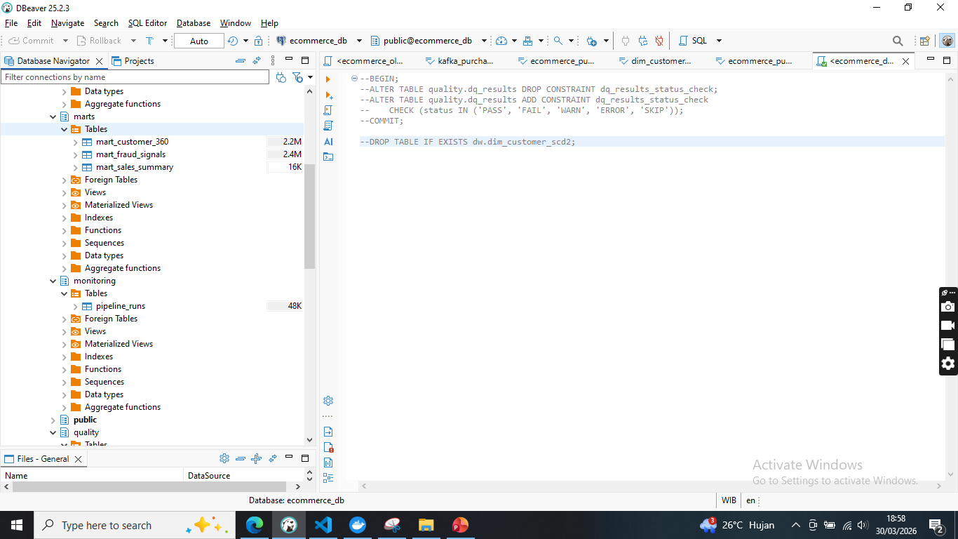

Slide 22
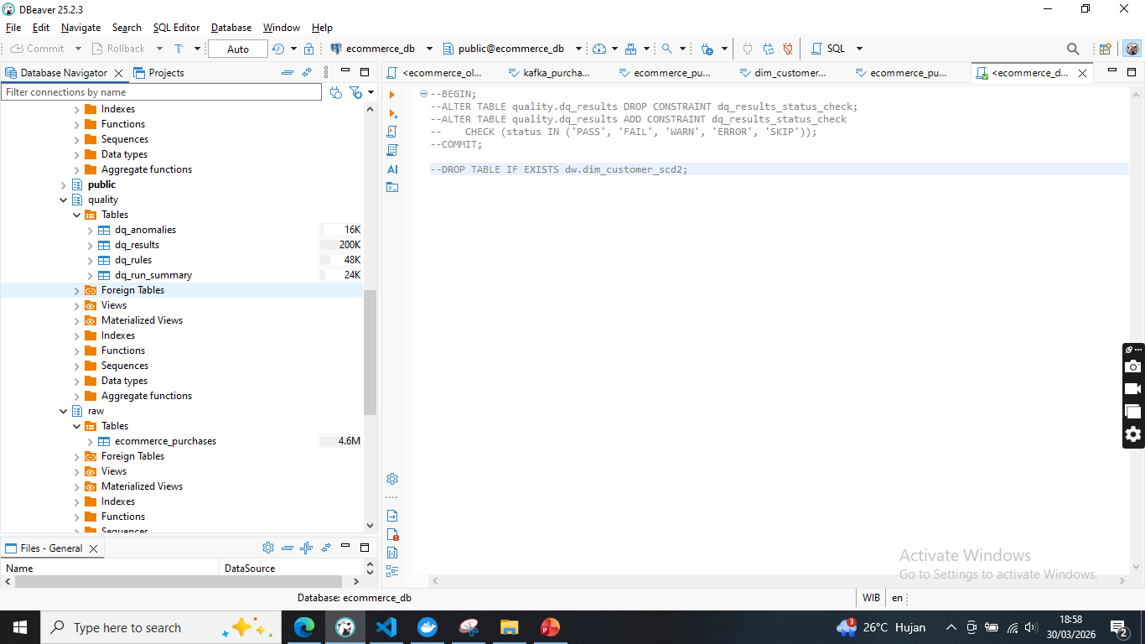

Slide 23
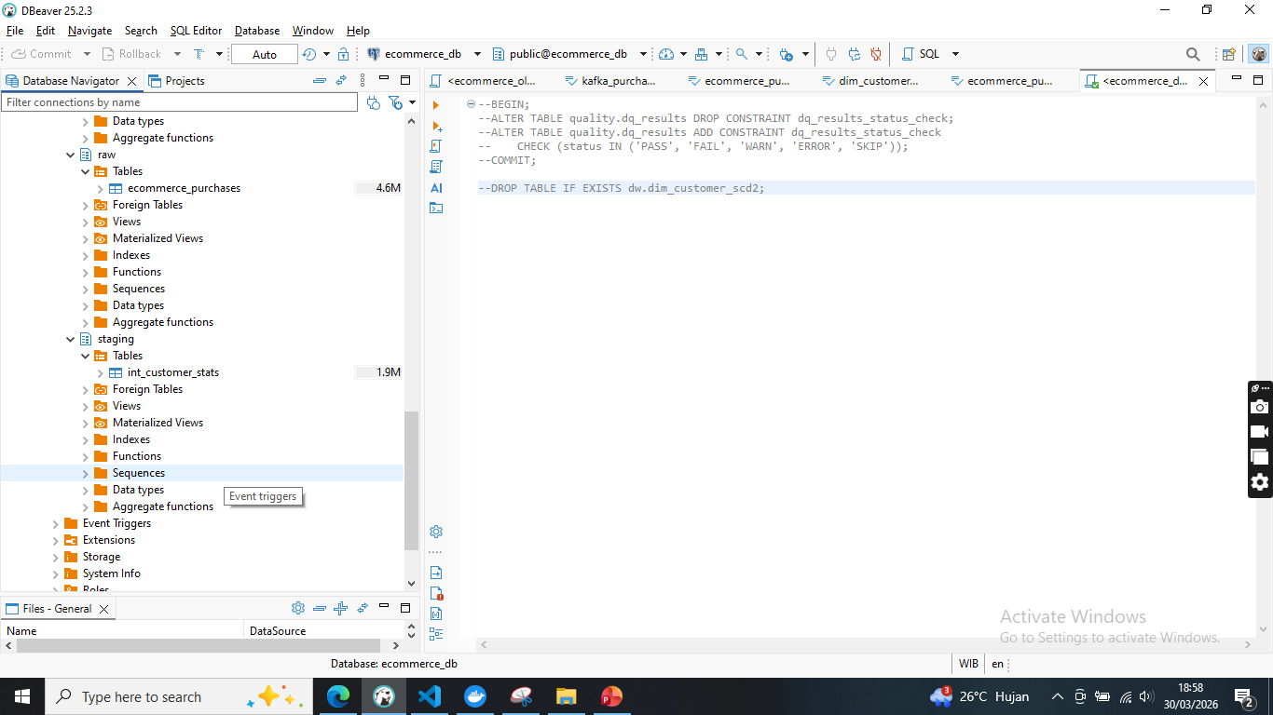

Slide 24
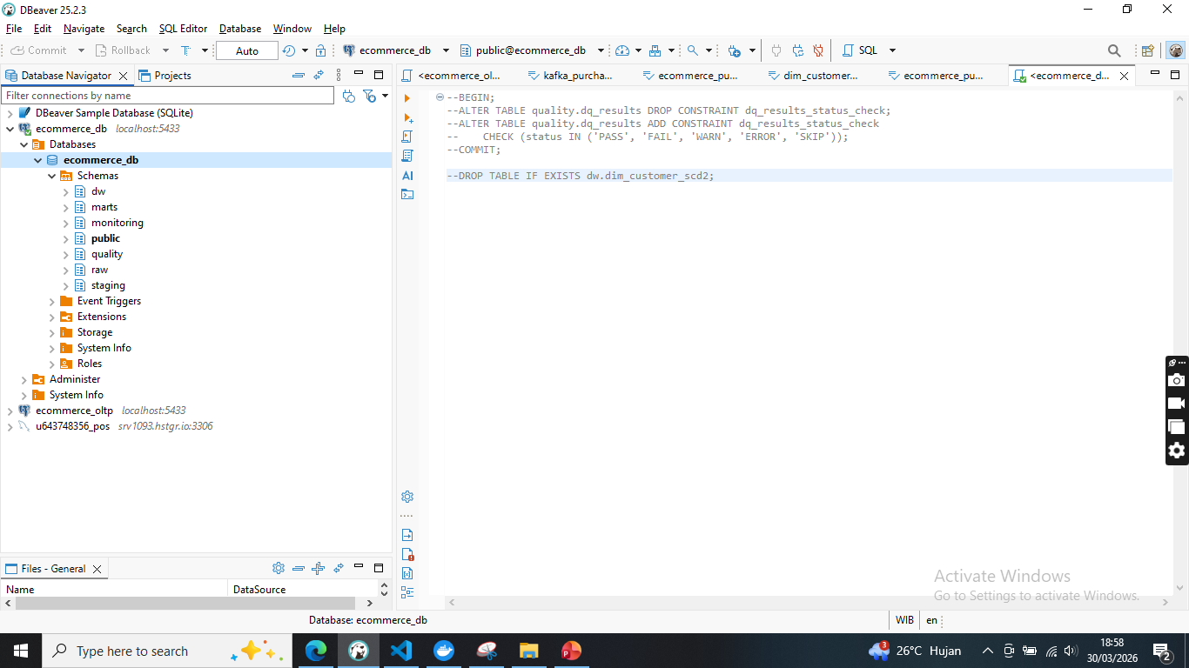

Slide 25
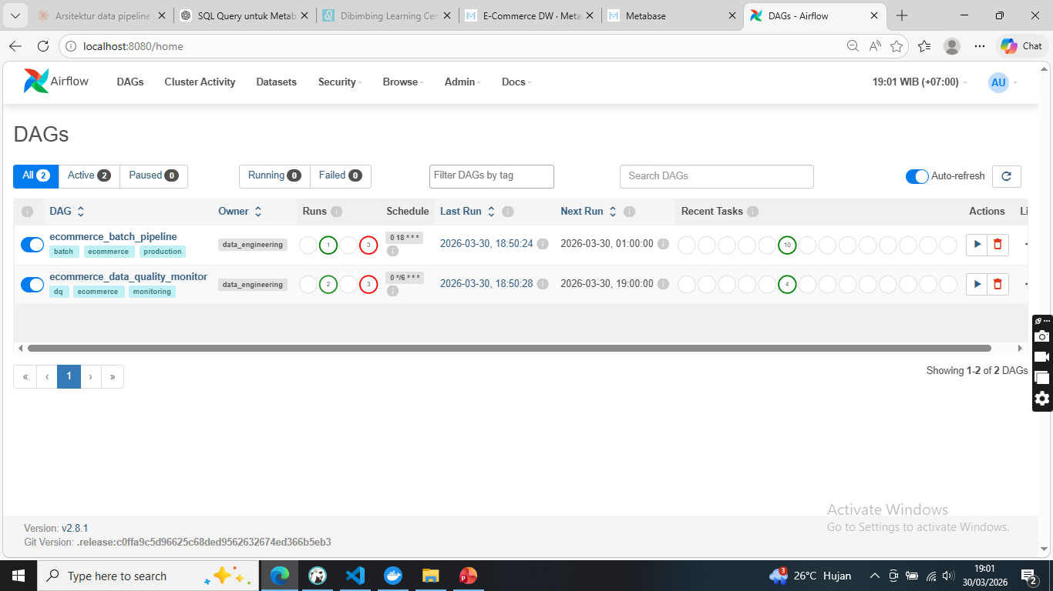

Slide 26
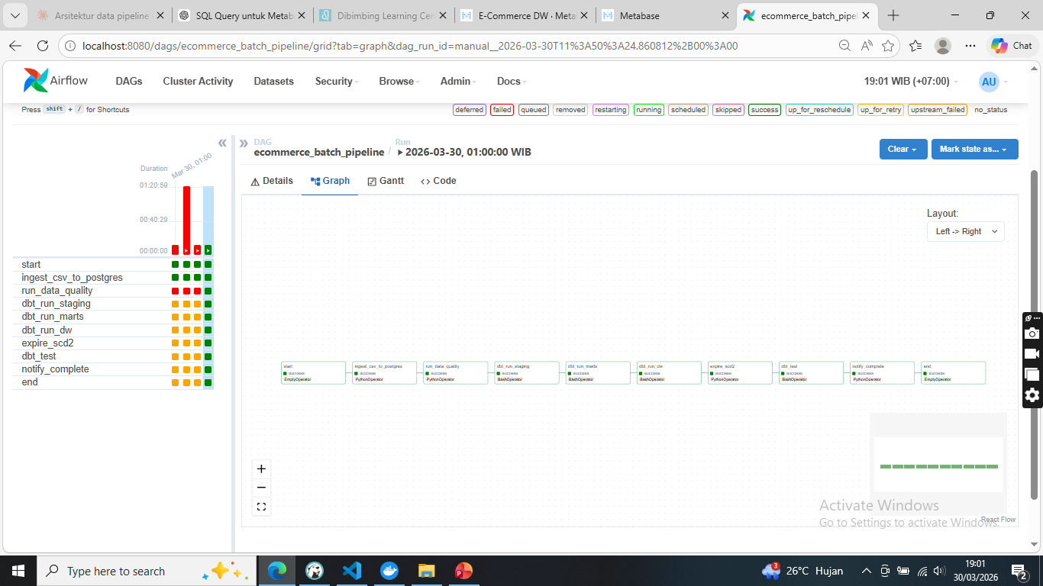

Slide 27
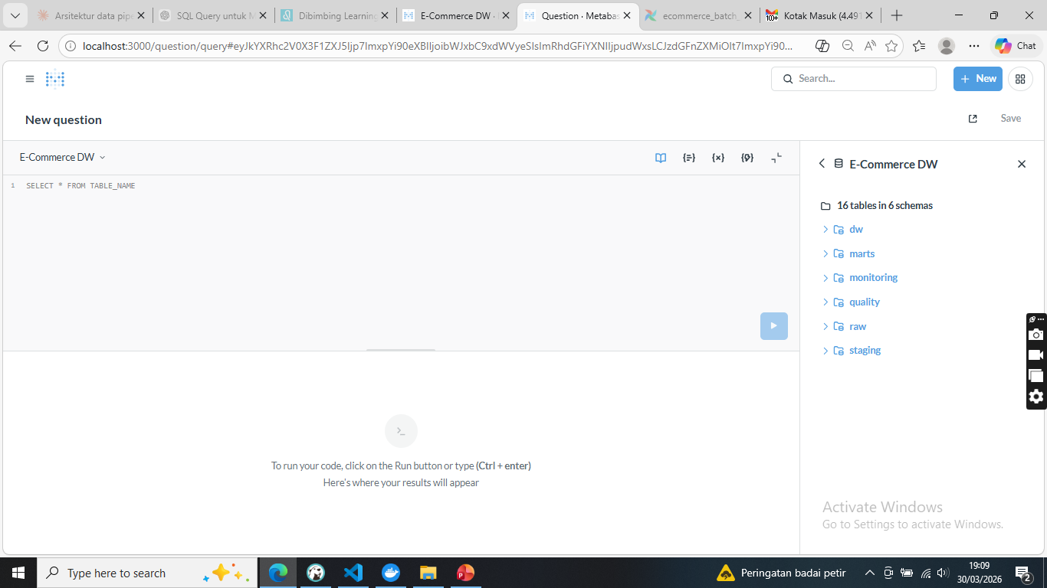

Slide 28
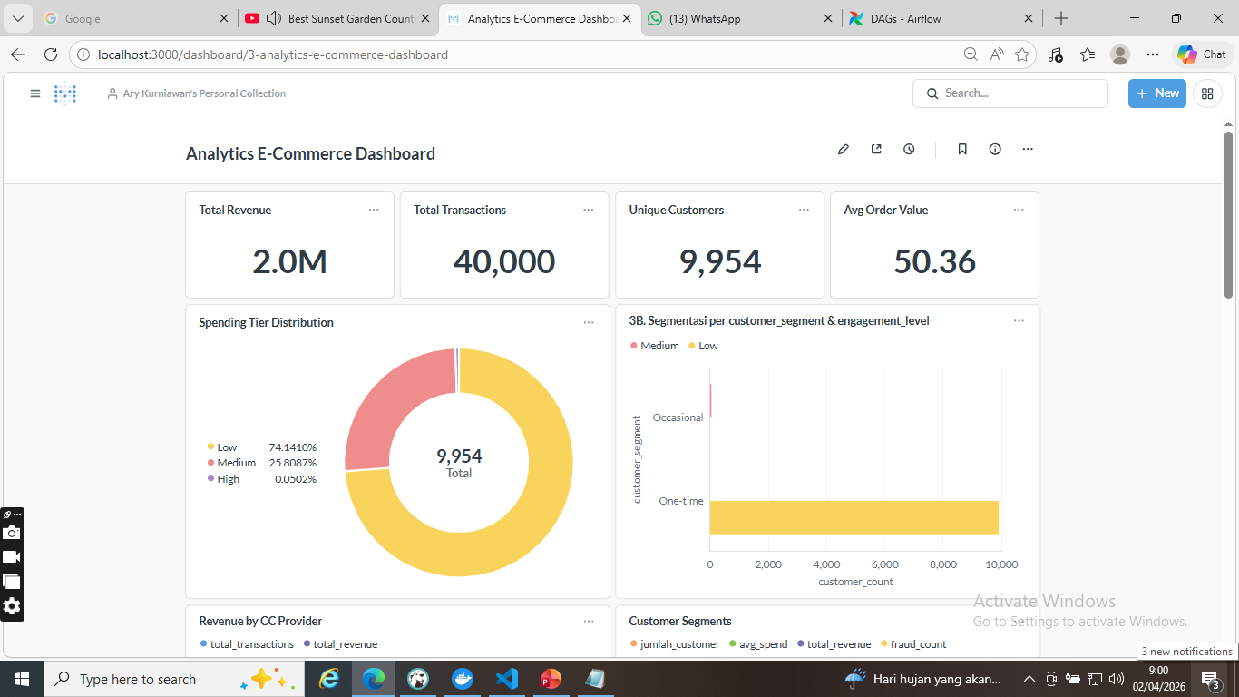

Slide 29
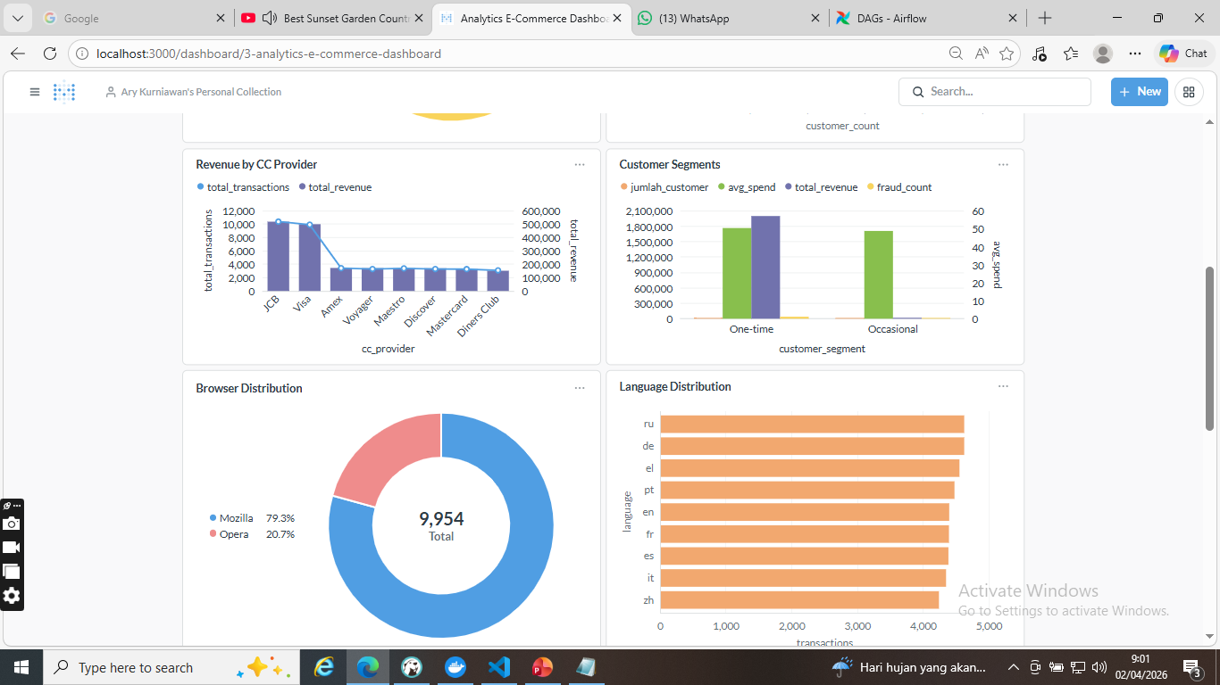

Slide 30
